Slide 1
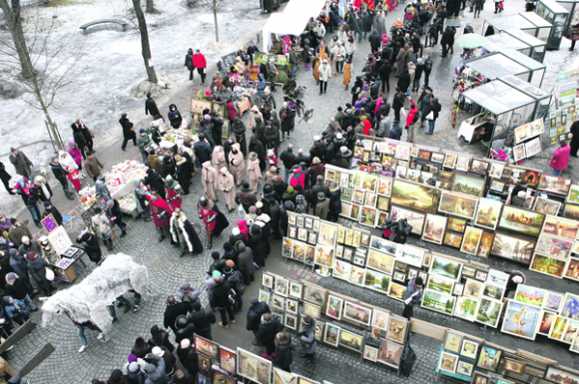
The fair of Kaziukas in Lithuania

Slide 2
What is Kaziukas?
Kaziukas Fair, known as Kaziuko Mugė in Lithuania, is a springtime fair that features traditional arts, crafts, and souvenirs. It is a great place to pick up Lithuanian souvenirs and handmade goods.
Kaziukas Fair is held at the end of February or the beginning of March – the weekend which falls closest to St. Casimir's Day (March 4) .

Slide 3
Nowadays people gather to Kaziuko mugė not to buy something practical, but more to find something beautiful and authentic, reflecting national Lithuanian spirit and culture for their home.

Slide 5
Lithuanian fair today
Today, Kaziukas fair also features music and dance; it attracts tens of thousands of visitors and many craftsmen from all over the country as well as from neighbouring states such as Latvia, Russia, and Poland.

Slide 6
Kaziuko fairy history
It begun since 1602 year, November 7 , when pope Clemens VIII official publicationed Cassimier holy. After that, he was Lithuanian guardian, so his pround people does Kaziuko fairy (Kaziukas is a diminutive of Casimir).

Slide 8
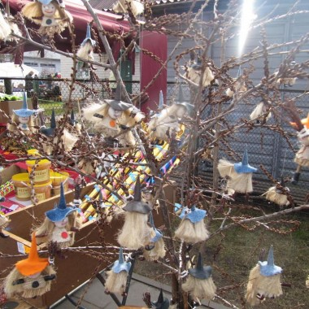
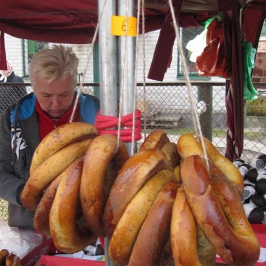
Kaziukas fair in Varėna

Slide 9
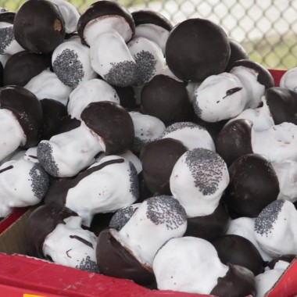
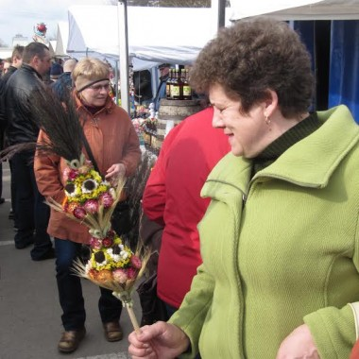

Slide 10
Kaziukas in Vilnius
Things | How people buy it (%)
Unique things Souvenirs Sweet things Palms Appliances Other stuff | 15 10 25 32 15 3

Slide 11
Kaziukas in Kaunas

Slide 12
Kaziukas fair 2013 Vilnius

Slide 13
Comenius multilateral project
LERBISH
Lithuania, Varėna
Viktorija Juščenko

