Slide 1
Song celebrations

Slide 2


Slide 3
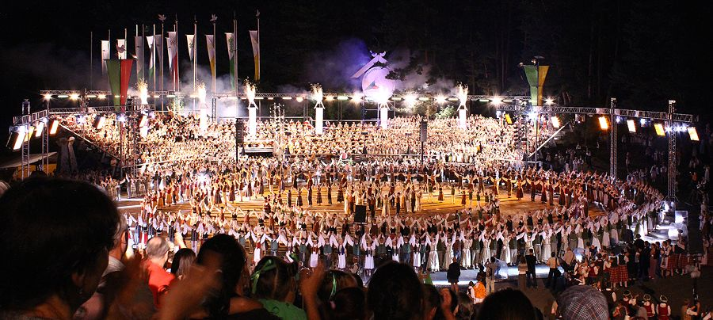
This is the huge festival which brings together thousands of professional and lover musicians, singers and dancers, from very young to old, from all over the world.

Slide 4
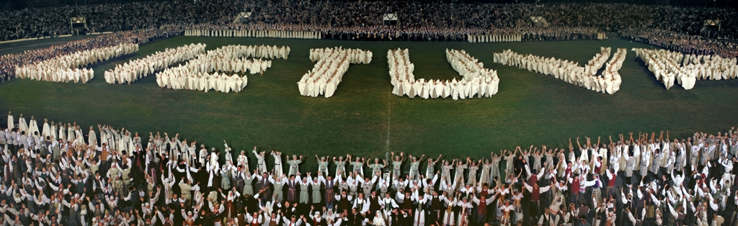
The Festival has several layers: Folk Art Exhibition, Folklore Day, Ensemble Evening, Dance Day, and Song Day, The Folklore Day.

Slide 5
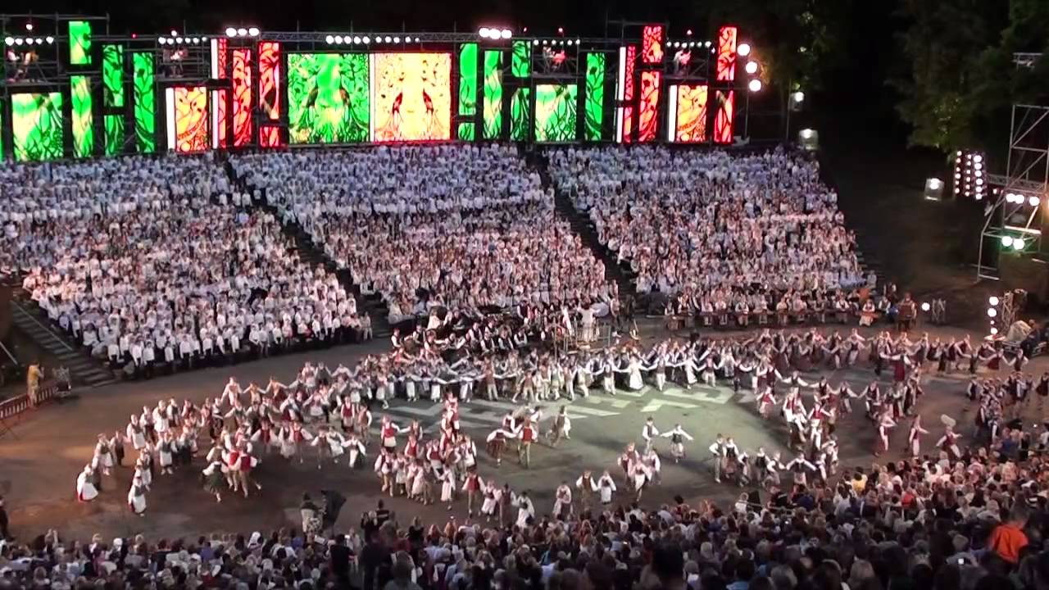
It is traditionally held in the Sereikiškių Park.

Slide 6
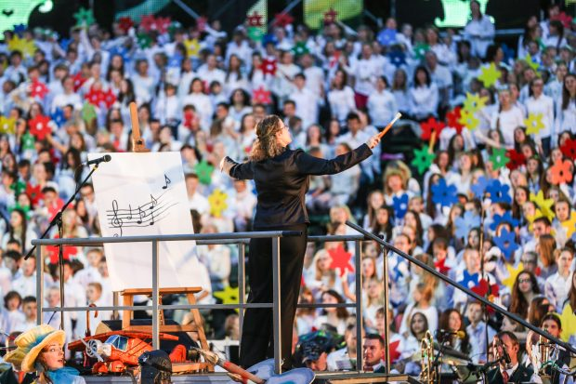
The final and the most impressive touch of the Festival is the Song Day, which is traditionally held in Vingis Park, on the open-air stage specially built for this purpose.

Slide 7
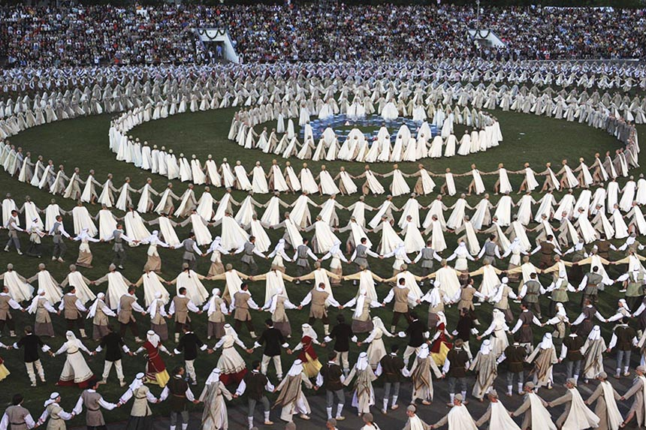
Dance Days take place in the Žalgiris Stadium.

Slide 8
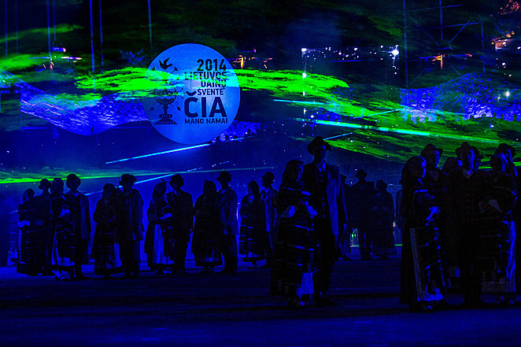

Slide 9
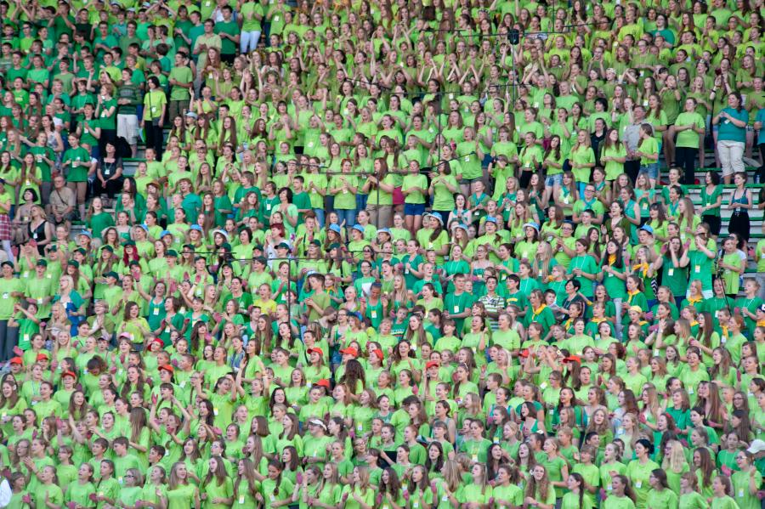

Slide 10
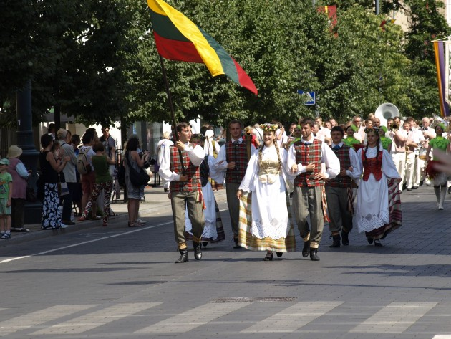

Slide 11
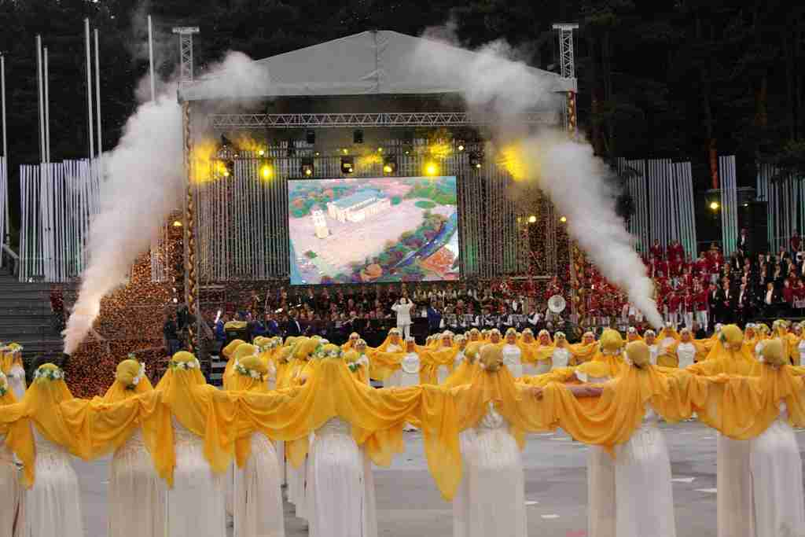

Slide 12
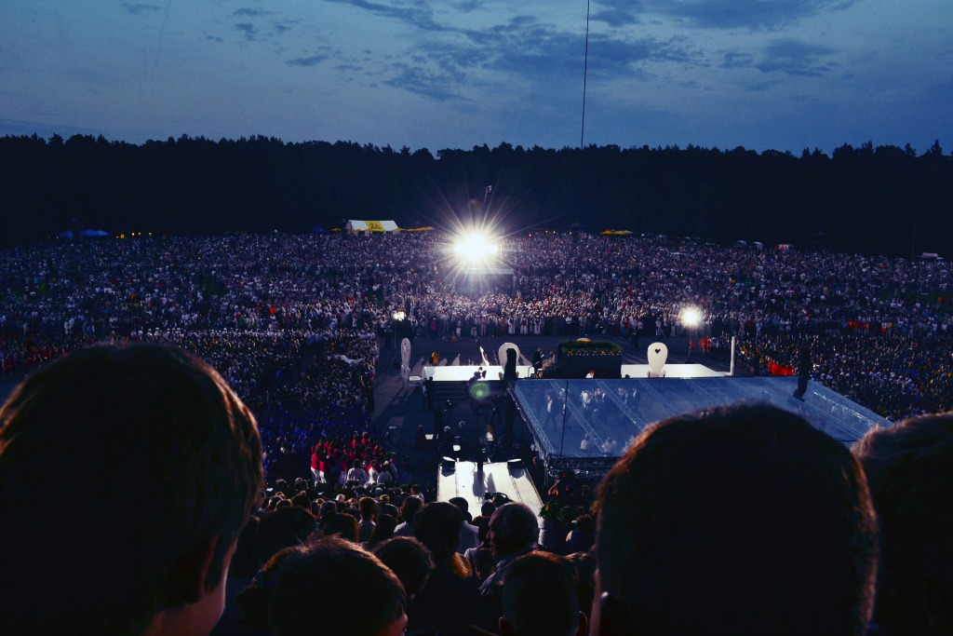

Slide 13
Thanks for watching ! ☺

Slide 14
Comenius multilateras project
Lerbish, lithuania varėna

